Slide 1

Supply Chain and Targeted HFA Spot Checks
Country report: ABCD
[period of survey]
Date:
Disclaimer: “The opinions expressed in this presentation and on the following slides are solely those of the presenter and not necessarily those of IQVIA. IQVIA does not guarantee the accuracy or reliability of the information provided herein.”

Slide 2
Introduction & objectives
Objectives of Spot-checks & tHFA
Process - Steps involved & where we are now…
Technical details – We went to Sampled facilities, (# of HFs) with select, tracers list (# of tracers), & also at central level and following 5 indicators assessed for performance
Why – Shift in TGF strategy to focus on IPCQS, community health. Collecting performance framework metrics to monitor progress

Slide 3
Introduction & Objectives
Country-Specific Message
Adapt to highlight KPI and non-KPI measurement priorities
CT priorities can also find a place here

Slide 4
Key tHFA sections with KPI and Non-KPI with broader message
Sections level details (take from previous slides
KPI and Non KPI linked to each section
Subcomponents of each indicator

Slide 5



Table of Contents
1. Executive Summary
2. Methodology
3. Key Findings
and Insights
Provides a description of the sampling, data quality assurance and the analysis approach, as well as challenges encountered in methodology, if any.
Summarizes the scope, key findings and highlights for the country.
Reflects the key findings and highlights.

Slide 6


1. Executive Summary
2. Methodology
3. Key Findings
and Insights
Provides a description of the sampling, data quality assurance and the analysis approach, as well as challenges encountered in methodology, if any.
Summarizes the scope, key findings and highlights for the country.
Reflects the key findings and highlights.

Slide 7
Executive Summary
Summary of Key findings for the KPI & non- KPI indicators being measured
Summarize the rationale for some of the measures including any qualitative on-field observations or country specific context that explains the results

Slide 8

1. Executive Summary
3. Key Findings
and Insights
2. Methodology
Provides a description of the sampling, data quality assurance and the analysis approach, as well as challenges encountered in methodology, if any.
Summarizes the scope, key findings and highlights for the quarter.
Reflects the key findings and highlights.

Slide 9
Methodology: Sampling
MFL used
Sampling – panel and random; any deviation in sampling based on CT requirements;
HTM availability in MFL compared to sampling chart
Any back-up facilities used etc
Final sample collected

Slide 10
Methodology: Training and Data collection
Training process; material, pre-post test; enumerator finalization
Team composition and structure
Data collection process

Slide 11
Methodology: Data quality process
Detailed QC process before data collection, during data collection (field level) and post data collection (at desk-level)
Before data collection: Survey CTO checks inbuilt etc
Field level: spot checks, telephonic confirmations, back-checks; add back check results
Post field/desk-level: detailed data quality checks e.g. duplicates, outliers etc and data cleaning steps
IDQA results where applicable

Slide 12
Methodology: Data Analysis approach
Adapt using annex 1 shared

Slide 13
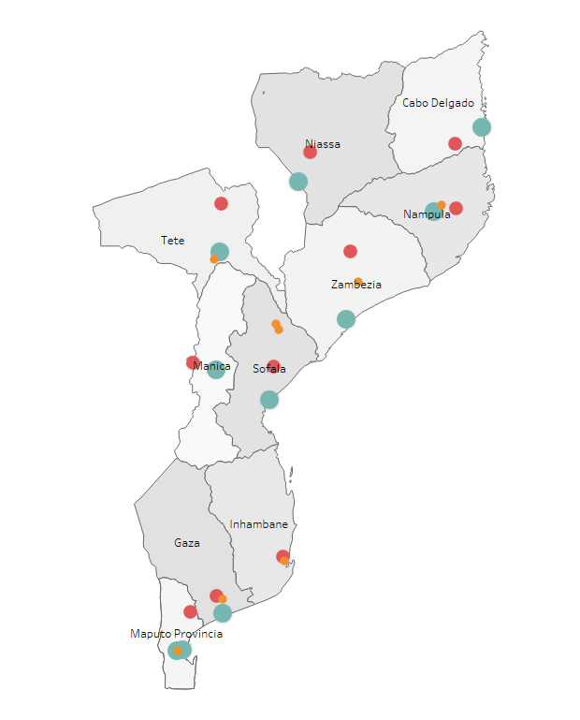



Facility demographics and service availability mapping
Supply Chain and Health Services Dashboard
Map of Mozambique showing Geocoordinate mapping of visited facilities
Distribution of health facilities visited by facility type, % (number)
42% (33)
21% (16)
Primary Health care facilities
N = 78
Secondary Health care facilities
Tertiary Health care facilities
37% (29)
Distribution of health facilities by services provided, %
Facility type
HIV
TB
Malaria
COVID-19
Primary health care
facilities
Central Medical Stores
Secondary health care facilities
Primary Facilities
Secondary Facilities
Tertiary health care
facilities
Tertiary facilities

Slide 14
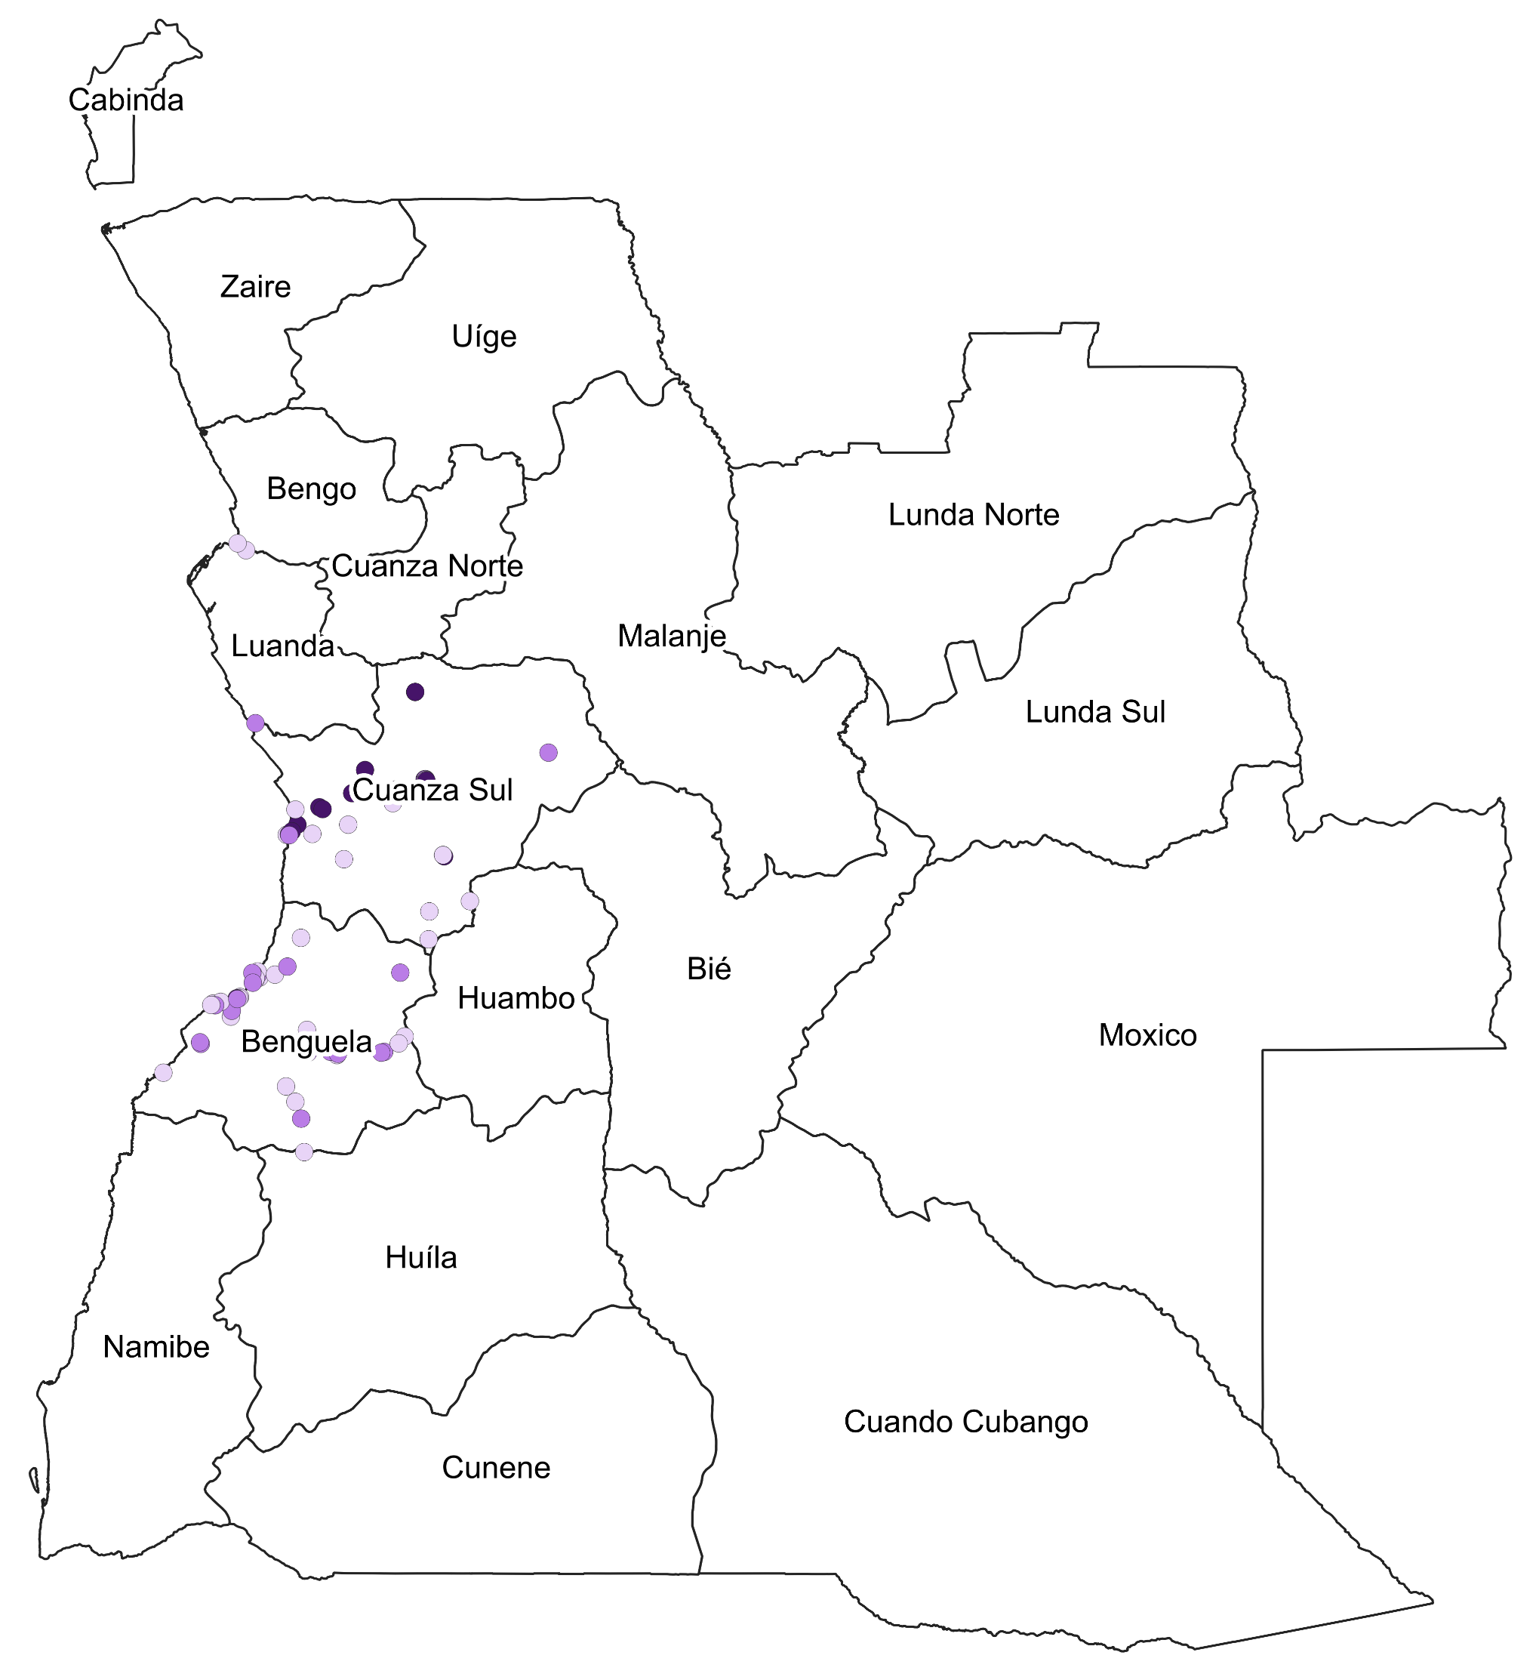
Facility demographics and service availability mapping
Supply Chain and Health Services Dashboard
Distribution of services provided by location and facility type, %
Map of Angola showing geographical spread of visited facilities
Facility location
HIV
TB
Malaria
ANC
Immu.
Health care facilities in
rural areas
N/A
Health care facilities in
peri-urban areas
Health care facilities in
urban areas
Facility type
HIV
TB
Malaria
ANC
Immu.
Primary health care
facilities
N/A
Secondary health care facilities
Tertiary health care
facilities

Slide 15
1. Executive Summary
3. Key Findings
and Insights
2. Methodology
Provides a description of the sampling, data quality assurance and the analysis approach, as well as challenges encountered in methodology, if any.
Summarizes the scope key findings and highlights for the quarter.
Reflects the key findings and highlights.

Slide 16
Country level score for 10 tHFA Indicators
<<Identify areas which are going well, and where we need more work>>
Add chart to show all indicator scores on this page

Slide 17

Country level scores for the 11 tHFA indicators
Supply Chain and Health Services Dashboard
1
11 tHFA Indicators
11
2
Provision of integrated, people-centered, high-quality services
Provision of integrated supportive supervision
HTM integrated services offered to pregnant women
Systems readiness for CHWs
Composite facility level indicator for effective services
% of community health workers remunerated on time and in-full
% of facilities with community-led monitoring mechanism
% of facilities with clinical guidelines for HIV, TB, malaria and/or PHC
% of facilities able to provide oxygen therapy related services among those providing the service
% of facilities that have an appropriate set of diagnostics for their healthcare facility level
Vacancy rate: Ratio of unfilled posts to total number of posts
10
3
9
4
Malawi
8
5
7
6
Add chart to show all indicator scores on this page

Slide 18
KPI 1 : Provision of integrated, people-centered, high-quality services
Supply Chain and Health Services Dashboard
Country level indicator
11 tHFA Indicators
Primary health care
facilities
Secondary health care facilities
Tertiary health care
facilities
Add chart to show all indicator scores on this page
People-centeredness
Health worker competence

Slide 19
RSSH/PP HRH-7: Deep dive
Here we show the break down of the components feeding into the KPI and highlight the ones which are driving the numbers
Add any qualitative or country specific context or reasoning explaining the values for the components

Slide 20
So what is working well & what could improve – Conclusion
Works well
Areas of improvement
4-5 lines
Potential for improvement or areas where we see risks

Slide 21
What things could help with improving ? For open discussion
More like these might work rather than definitive statements

Slide 22
Thank you

Slide 23
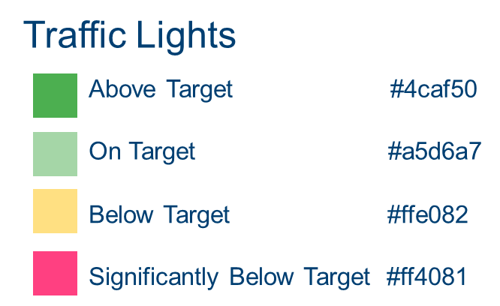
Performance thresholds and color codes
To use for KPI calculations
Performance thresholds
Color codes

Slide 24
Scope 1/3
What information/data are being collected in the questionnaire?
1. Facility Information​ | Facility location, type, level, services provided (HIV/AIDS, TB, Malaria, COVID-19).
2.1 Staff Impacted​ | Information related to staff availability and impacted by COVID-19​.
2.2 PPR-IPC​ | Information related to pandemic preparedness and response (PPR) including infection, prevention and control (IPC)​.
2.3 O2 Readiness​ | Information related to oxygen therapy readiness to provide services​.
2.4 Financing and Reporting​ | Information related to financing modalities and reporting status during COVID-19​.
2.5 Labs and Waste Management​ | Information related to waste collection and disposal management, and laboratory systems.​
2.6 COVID-19 Capacity​ | Information to assess the COVID-19 clinical pathway capacity of a health facility from testing to treatment​.
3. HIV, TB and Malaria Service Volume​ | Information from register records among services from 2019 to date.

Slide 25
Scope 2/3
4.1 Supply Chain HF OSA​​ | Data for the supply chain KPI “On-shelf Availability” for the selected tracer products belonging to the HIV, TB, malaria and COVID-19 product groups in scope for the Spot Checks at the health facility level. ​​
4.2 Supply Chain HF LMIS ​​ | Data on the quality of the data submitted to the country’s Logistics Management Information System (LMIS) for the HIV, TB, malaria and COVID-19 disease components at the health facility level. Three (3) key data quality elements are considered: data completeness, data accuracy and data timeliness. In addition, this section collects data on key challenges hindering the ability of health facilities to submit quality LMIS data to the central level. ​​
5.1 Supply Chain CMS OTIF​​ | Data for the supply chain KPI “On-Time-In Full” for the selected tracer products belonging to the HIV, TB, malaria and COVID-19 product groups in scope for the Spot Checks at the central storage facility (central level only). In addition, this section collects data on reasons impacting the central storage facility’s ability to deliver the right products in the right quantity and at the right time to the next supply chain level. ​​
5.2 Supply Chain CMS SATP​​ | Data for the supply chain KPI “Stocked According to Plan” for the selected tracer products belonging to the HIV, TB, malaria and COVID-19 product groups in scope for the Spot Checks at the central storage facility (central level only); data on the underlying reasons for stock imbalances (overstock, under stock, stock out situations). ​​

Slide 26
Scope 3/3
6. Supply Chain Central LMIS​​ | Data for the supply chain KPI “Facility Reporting to the LMIS” for the for the HIV, TB, malaria and COVID-19 disease components at the national level​​.
7. GSDP Questionnaire | Data for the Good Storage and Distribution Practice questionnaire. Five main sections of the questionnaire include: Preparatory information on prior audits; License and Registration; Quality Systems and Controls; Storage Capacity; Cold Chain Storage.

